Slide 1
HTML - Tables - rows - cells -width -height Table commands - row span - column span - borders - padding Nested Tables Save As Project_8.html
Internet Programming
Project 6a

Slide 2
Open notepad and add the text found at the left.
Save as
“Project 6a.html”
<html> <head>
<title>
Your Name
</title>
</head>
<body bgcolor="#c2c2c2">
This is my eight page…..
</body> </html>

Slide 3
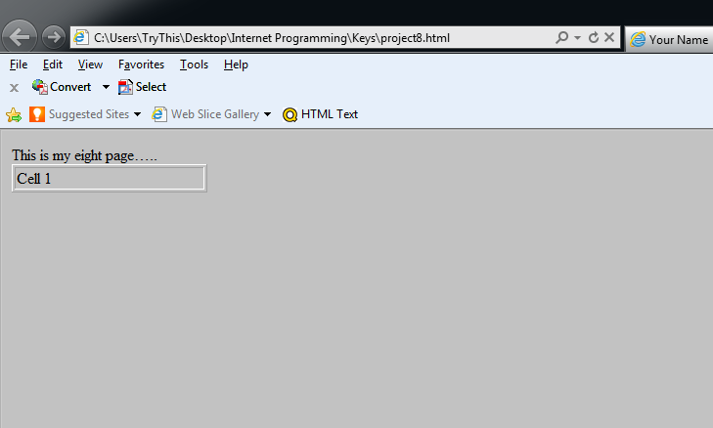
Add the green text
at the left and view your page
<html>
<head>
<title>
Your Name
</title>
</head>
<body bgcolor="#c2c2c2">
This is my eight page…..
<table width="200" border="1">
<tr>
<td>Cell 1</td>
</tr>
</table>
</body>
</html>

Slide 4
Add the green text on the left
Save you file as Project_5a.html
View your page
</title>
</head>
<body bgcolor="#c2c2c2">
This is my eight page…..
<table width="200" border="1">
<tr>
<td>Cell 1</td>
<td>Cell 2</td>
<td>Cell 3</td>
</tr>
</table>
</body> </html>

Slide 5
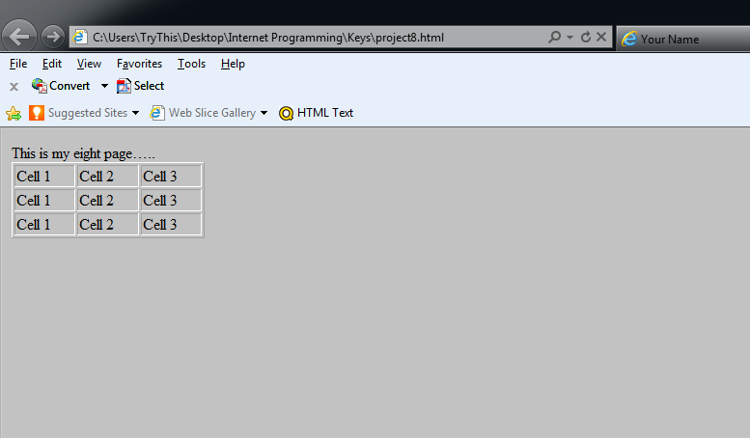
Add the green text on the left
Save you file as Project_5a.html
View your page
<table width="200" border="1">
<tr>
<td>Cell 1</td>
<td>Cell 2</td>
<td>Cell 3</td>
</tr>
<tr>
<td>Cell 1</td>
<td>Cell 2</td>
<td>Cell 3</td>
</tr>
<tr>
<td>Cell 1</td>
<td>Cell 2</td>
<td>Cell 3</td>
</tr>
</table>
</body> </html>

Slide 6
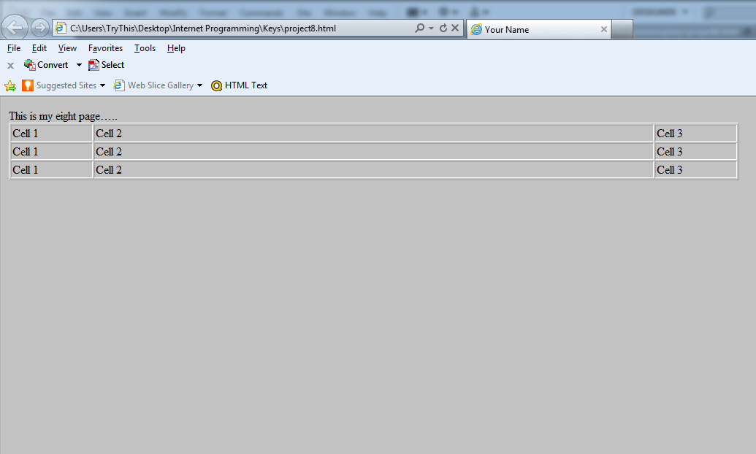
Add the green text on the left
Monitor size
1024 X 768
Save you file as Project_8.html
View your page
<table width=“1000" border="1">
<tr>
<td width="110">Cell 1</td>
<td width=“780">Cell 2</td>
<td width="110">Cell 3</td>
</tr>
<tr>
<td>Cell 1</td>
<td>Cell 2</td>
<td>Cell 3</td>
</tr>
<tr>
<td>Cell 1</td>
<td>Cell 2</td>
<td>Cell 3</td>
</tr>
</table>
</body> </html>

Slide 7
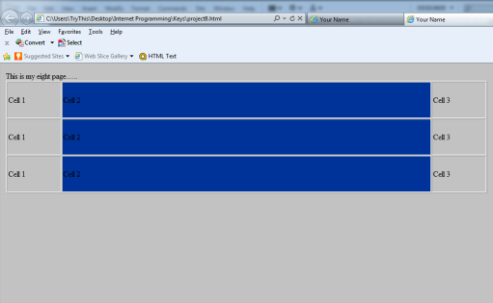
Add the green text on the left
Save you file as Project_5a.html
View your page
<table width="1000" border="1">
<tr>
<td width="110" height="75">Cell 1</td>
<td width="780" bgcolor="#003399">Cell 2</td>
<td width="110">Cell 3</td>
</tr>
<tr>
<td height="75" >Cell 1</td>
<td bgcolor="#003399">Cell 2</td>
<td>Cell 3</td>
</tr>
<tr>
<td height="75">Cell 1</td>
<td bgcolor="#003399">Cell 2</td>
<td>Cell 3</td>
</tr>
</table>

Slide 8
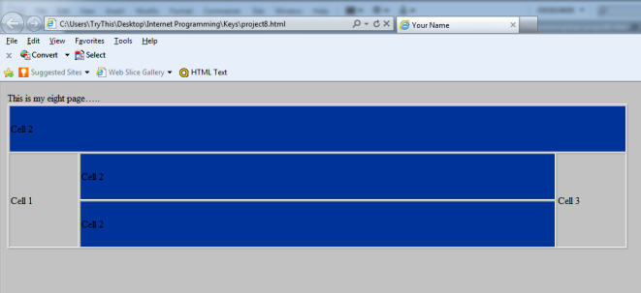
Add the green text on the left
Remove cell1 and
cell3 from the
first row
Remove cell1 and
cell3 from the
last row
Save you file as Project_5a.html
View your page
<table width="1000" border="1">
<tr>
<td height="75" colspan="3" bgcolor="#003399">Cell 2</td>
</tr>
<tr>
<td width="110" rowspan="2" >Cell 1</td>
<td width="780" height="75" bgcolor="#003399">Cell 2</td>
<td width="110" rowspan="2">Cell 3</td>
</tr>
<tr>
<td height="75" bgcolor="#003399">Cell 2</td>
</tr>
</table>

Slide 9
Add the green text on the left
Save you file as Project_5a.html
View your page
<body bgcolor="#c2c2c2">
This is my eight page…..
<table width="1000" border="4" align="center" cellpadding="12">
<tr>
<td height="75" colspan="3" bgcolor="#003399">Cell 2</td>
</tr>

Slide 10
Add the green text on the left
Add a nested table in the first cell
Remove the text cell2
Save you file as Project_5a.html
View your page
<table width="1000" border="4" align="center" cellpadding="12">
<tr>
<td height="75" colspan="3" bgcolor="#003399">
<table width="800" border="1">
<tr>
<td>Heading 1</td>
<td bgcolor="#C2C2C2">Heading 2</td>
<td>Heading 3</td>
</tr>
</table>
</td>
</tr>
<tr>

Slide 11
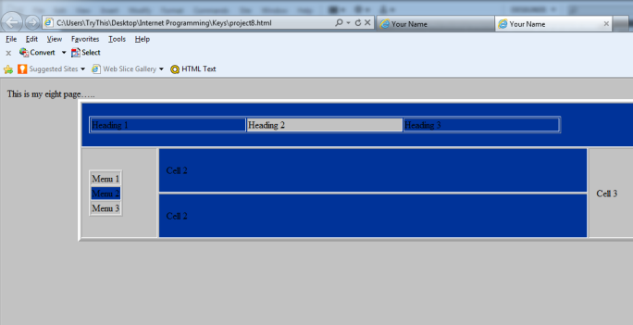
Add the green text on the left
Add a nested table in the first cell of row 2
Remove the text cell1
Save you file as Project_5a.html
View your page
<tr>
<td width="110" rowspan="2" >
<table border="1">
<tr>
<td>Menu 1</td>
</tr>
<tr>
<td bgcolor="#003399">Menu 2</td>
</tr>
<tr>
<td>Menu 3</td>
</tr>
</table>
</td><td width="780" height="75" bgcolor="#003399">Cell 2</td><td width="110" rowspan="2">Cell 3</td>
</tr>
<tr>
<td height="75" bgcolor="#003399">Cell 2</td>
</tr>
</table>

Slide 12
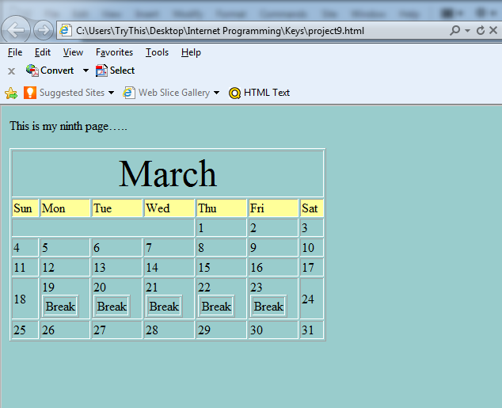
Create the March calendar
Save you file as
Project_5b.html
View your page
Span
Background =FFFF99
5 Nested tables 1x1
Page Background =99CCCC

